Slide 1
The Smartest AI Nutrition Assistant
CAPSTONE PROJECT
Presented By:
Name- Shubhangi Kad
College Name- MIT Academy Of Engineering
Department - Computer

Slide 2
OUTLINE
Problem Statement (Should not include solution)
Proposed System/Solution
System Development Approach (Technology Used)
Algorithm & Deployment
Result (Output Image)
Conclusion
Future Scope
References

Slide 3
Problem Statement
In today's health-conscious world, individuals increasingly seek personalized nutrition guidance. However, most existing tools provide generic meal plans, lack real-time adaptability, and fail to consider a person's cultural habits, allergies, evolving health conditions, or daily feedback. Additionally, nutritionists and dieticians face challenges in scaling personalized consultations due to time and resource constraints

Slide 4
Proposed Solution
A smart AI-powered Nutrition Assistant built using IBM Watsonx Assistant and Generative AI to deliver personalized, real-time meal plans. It understands user inputs (like allergies, health goals, preferences), provides nutritional advice, and adapts daily. The solution also includes features like grocery lists, calorie breakdowns, and workout tips, acting as a virtual dietician that improves with user feedback
Data Collection:
Collect user data: age, gender, dietary preference, allergies, health goals, activity levels
Use external APIs for nutrition data (e.g., USDA, Spoonacular), weather data, and health guidelines
Data Preprocessing:
Clean inputs to remove ambiguity or missing values
Extract features like calorie needs, allergy restrictions, time of day, and cultural food preference
Machine Learning Algorithm:
Clean inputs to remove ambiguity or missing values
Extract features like calorie needs, allergy restrictions, time of day, and cultural food preference

Slide 5
Proposed Solution
Deployment:
Integrated on IBM Cloud via Watsonx Assistant
Available through a chat-based interface (desktop or mobile browser)
Secure and scalable on IBM Cloud Lite
Evaluation:
Monitor chat flows and analyze user satisfaction with meal suggestions
Add feedback options for refining meal plans (e.g., like/dislike, allergy warning)
Update logic and options based on user inputs

Slide 6
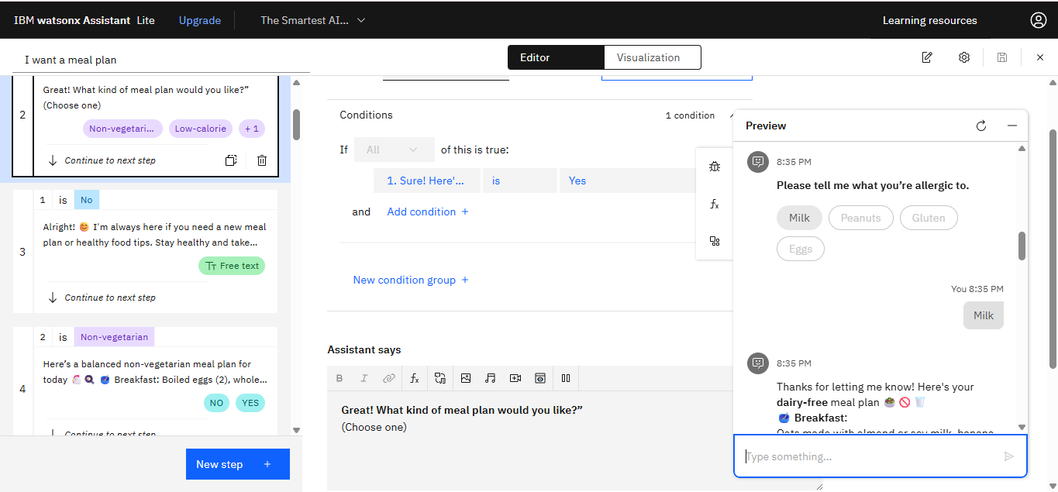
Proposed Solution
Result:
Dynamic and personalized nutrition assistant delivering
contextual meal suggestions and health advice instantly

Slide 7
System Approach
System Requirements
Operating System: Windows 10 / macOS / Linux
Web Browser: Chrome, Firefox, or Edge (for accessing Watsonx Assistant)
IBM Cloud Account: IBM Cloud Lite (free tier)
Watsonx Assistant: For building and deploying chatbot
Internet Access: For API integration (e.g., nutrition database)
Storage: IBM Cloud Object Storage (optional – for storing user preferences or logs)
Compute Resource: IBM Cloud Functions or IBM Code Engine (for logic if needed)
For Integration & Deployment:
Twilio API – for integrating Watsonx Assistant with WhatsApp chat interface

Slide 8
Algorithm & Deployment
Algorithm Selection:
For this project, a combination of rule-based logic, Natural Language Processing (NLP), and Generative AI (powered by Watsonx LLM) is used instead of traditional ML models like ARIMA or LSTM. The choice is based on the need for dynamic, personalized meal generation, natural conversation, and adaptability to diverse user inputs like allergies, fitness goals, and diet preferences.
Data Input:
The inputs considered for meal plan generation include:
User demographics: age, gender, weight, activity level
Stated preferences: vegetarian/non-vegetarian, allergies, low-calorie, high-protein, vegan, etc.
Time context: meal time (breakfast/lunch/dinner), or request for "tomorrow's plan"
Optional: health conditions (e.g., diabetes, weight loss), cultural food preferences

Slide 9
Algorithm & Deployment
Training Process:
Since generative models like Watsonx are pre-trained, the system leverages prompt engineering and fine-tuned examples within the Watsonx Assistant environment. Training is user-driven:
User input is mapped to entities and intents
Predefined action flows guide meal selection based on combinations of dietary needs
Feedback loops (like “Was this useful?”) improve future responses via manual tuning
Prediction Process:
The assistant processes the user's request using NLP to extract intent and constraints (e.g., "I want a low-calorie dinner without eggs").
A rule + prompt-based logic combines predefined templates with dynamic data (e.g., calorie range, allergies) to generate a personalized plan.
Responses adapt in real-time based on previous answers using contextual memory, and may include grocery lists, calorie counts, or workout tips.

Slide 10
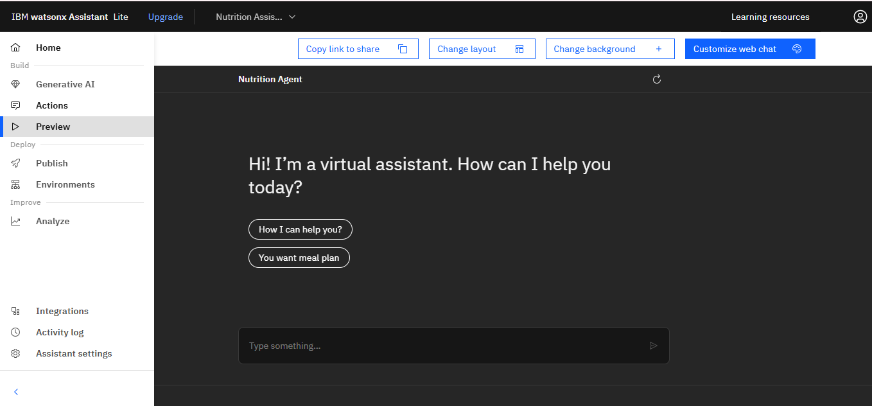
Result

Slide 11
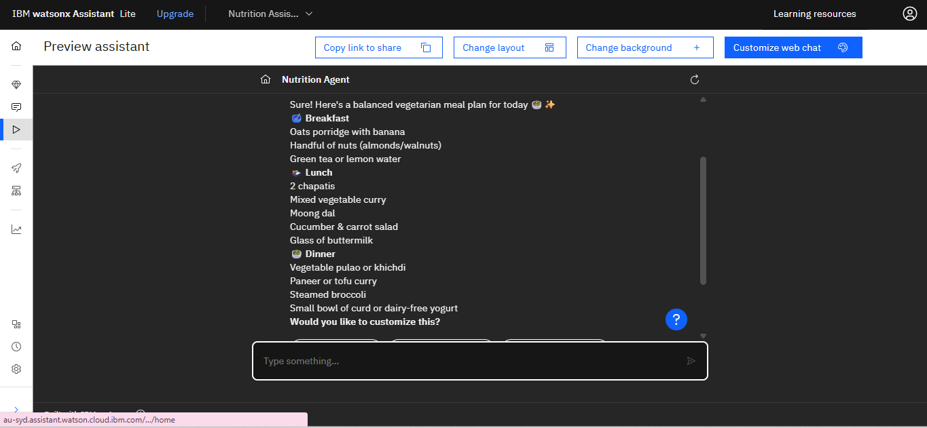
Result

Slide 12
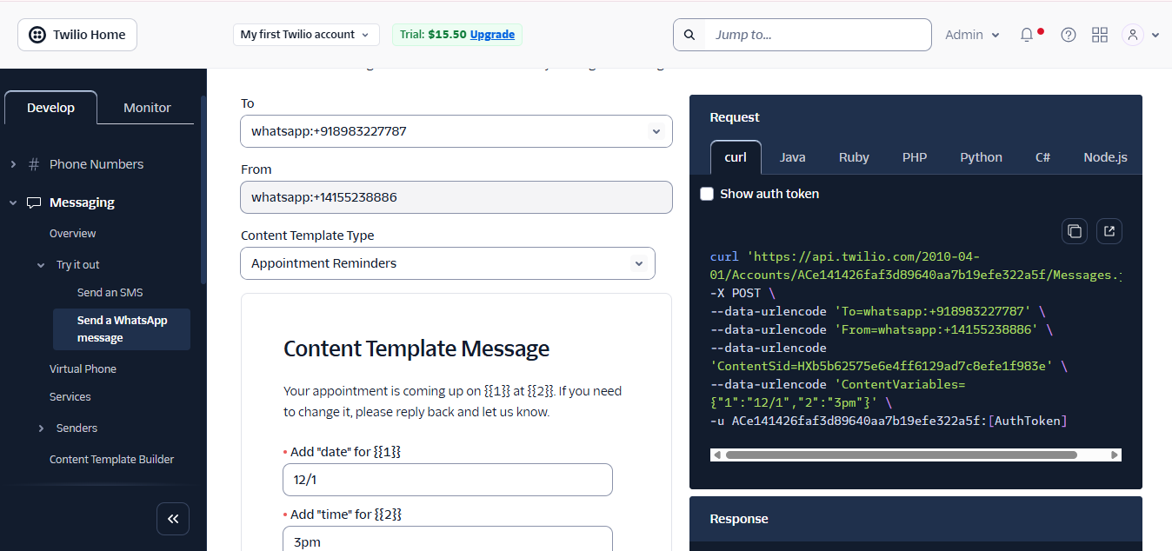
Result

Slide 13
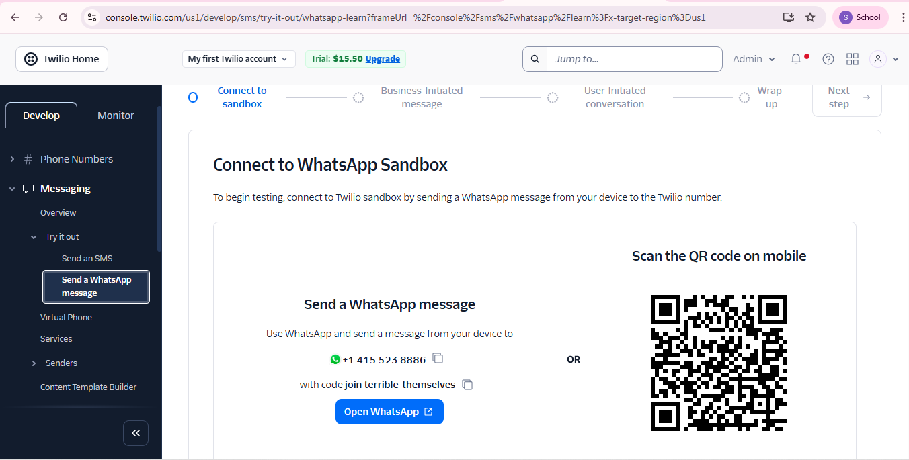
Result

Slide 14
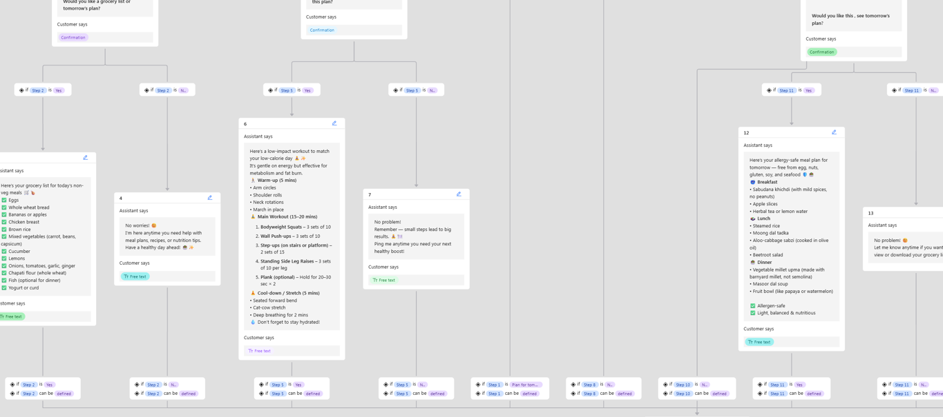
Result / visualization

Slide 15
Conclusion
The AI Nutrition Agent using IBM Watsonx Assistant effectively delivers personalized, real-time meal plans based on user input like allergies, health goals, and preferences. It improves user experience through dynamic suggestions, grocery lists, and fitness tips.
Challenges included handling varied inputs and complex logic flows. Future improvements can include image input, multilingual support, and fitness tracker integration.
Overall, the solution acts as a scalable, intelligent, and user-friendly virtual dietician, making healthy eating more accessible.

Slide 16
Future scope
The AI Nutrition Agent can be further enhanced and scaled in various ways:
Additional Data Integration: Incorporate health tracker data, regional cuisine databases, and medical records to improve personalization.
Advanced Machine Learning: Use deep learning models for more accurate meal recommendations and pattern recognition.
Image Recognition: Enable users to upload food images or labels for instant analysis.
Multilingual & Cultural Expansion: Support multiple languages and dietary customs to reach a wider audience.
Edge Computing: Allow offline processing for rural or low-connectivity areas.
Global Accessibility: Expand the system to support region-specific nutritional data and preferences, enabling global deployment.
These enhancements will make the system smarter, faster, and more adaptable—transforming it into a comprehensive AI health companion.

Slide 17
References
IBM Watsonx Assistant Documentation – https://www.ibm.com/cloud/watsonx-assistant
Twilio API for WhatsApp – https://www.twilio.com/whatsapp
IBM Developer: Build a nutrition chatbot using Watson – https://developer.ibm.com/articles/build-a-nutrition-chatbot-with-watson/
USDA FoodData Central – https://fdc.nal.usda.gov/
Spoonacular Food API – https://spoonacular.com/food-api

Slide 18
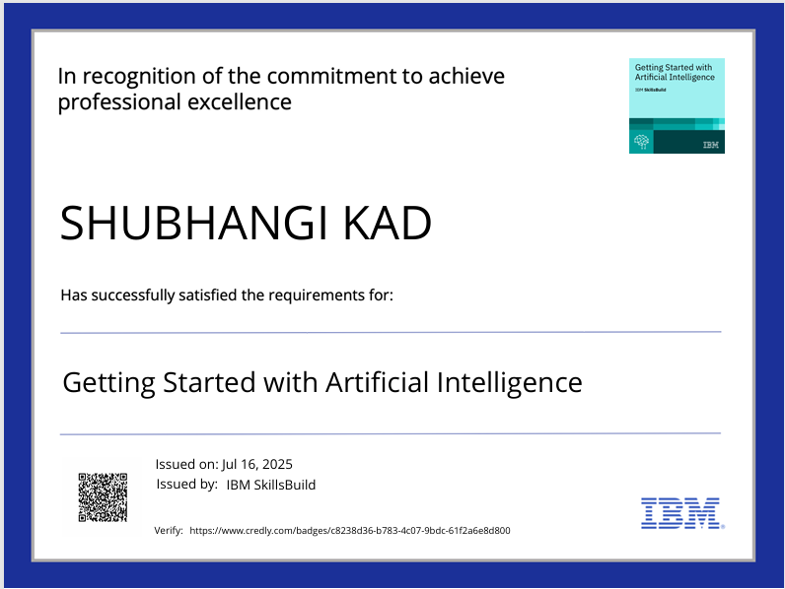
IBM Certifications

Slide 19
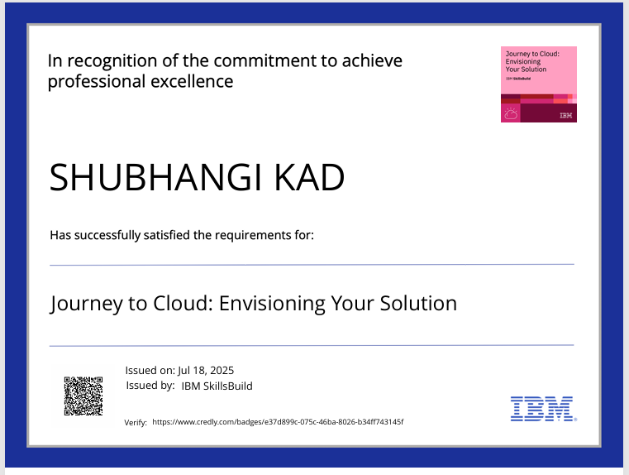
IBM Certifications

Slide 20
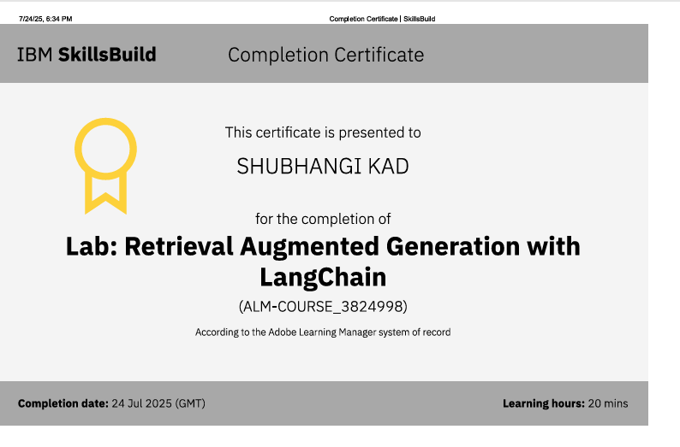
IBM Certifications

Slide 21
THANK YOU

